Slide 1
Tensorflow 기초 프로그래밍
https://github.com/hunkim/DeepLearningZeroToAll/blob/master/ipynb/lab-08-tensor_manipulation.ipynb

Slide 2
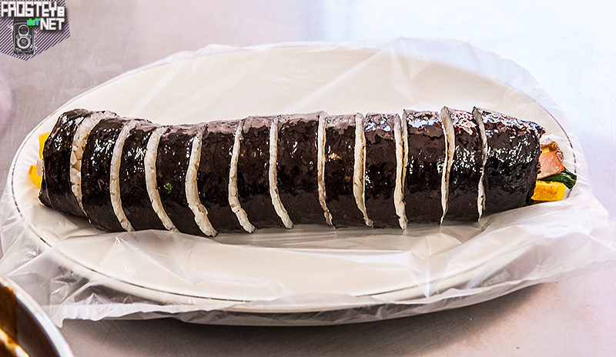
Simple 1D array and slicing
실습파일
1-1 mydnn_basic_tf.ipynb
t = np.array([0., 1., 2., 3., 4., 5., 6.])
Image from http://www.frosteye.net/1233

Slide 3
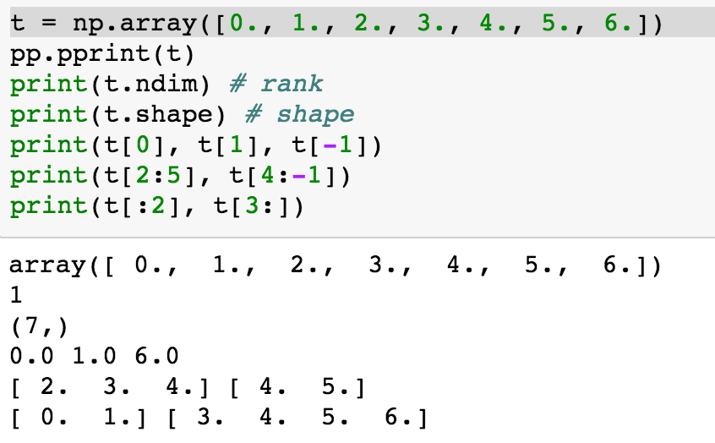
Simple 1D array and slicing
Image from http://www.frosteye.net/1233

Slide 4
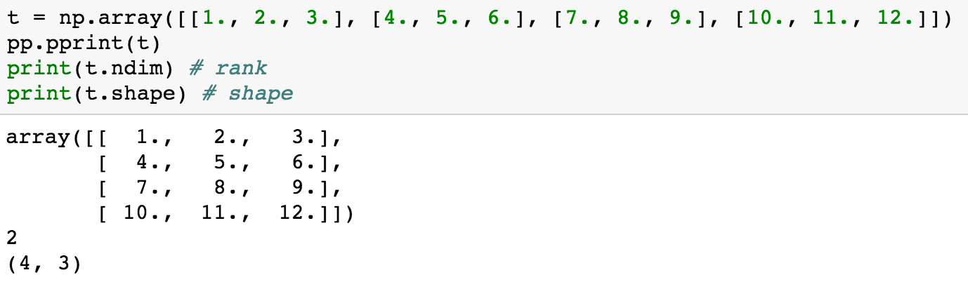
2D Array
https://github.com/hunkim/DeepLearningZeroToAll/blob/master/lab-08-tensor_manipulation.ipynb

Slide 5
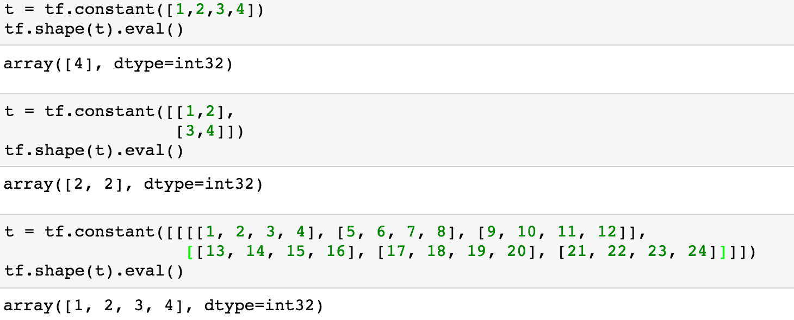
Shape, Rank, Axis
https://github.com/hunkim/DeepLearningZeroToAll/blob/master/lab-08-tensor_manipulation.ipynb

Slide 6
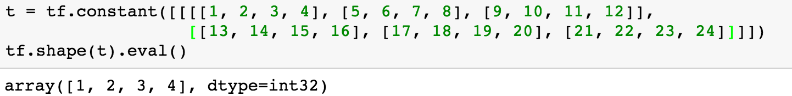
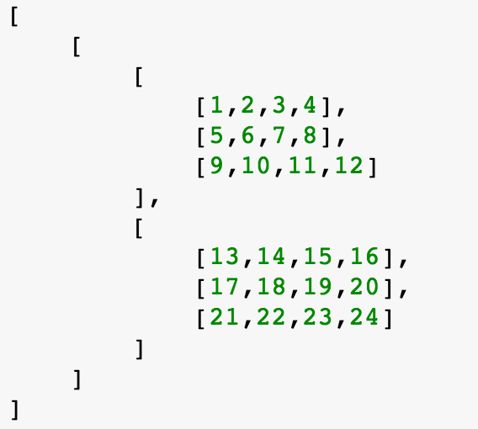
Shape, Rank, Axis
https://github.com/hunkim/DeepLearningZeroToAll/blob/master/lab-08-tensor_manipulation.ipynb

Slide 7
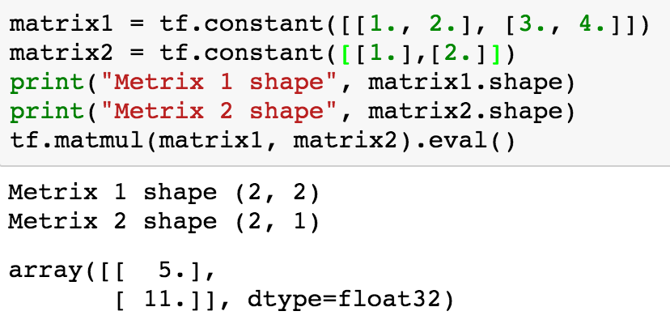
Matmul VS multiply
https://github.com/hunkim/DeepLearningZeroToAll/blob/master/lab-08-tensor_manipulation.ipynb

Slide 8
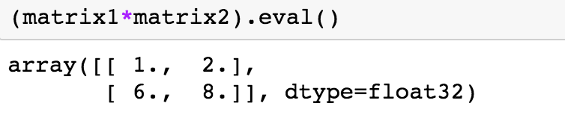
Matmul VS multiply
https://github.com/hunkim/DeepLearningZeroToAll/blob/master/lab-08-tensor_manipulation.ipynb

Slide 9

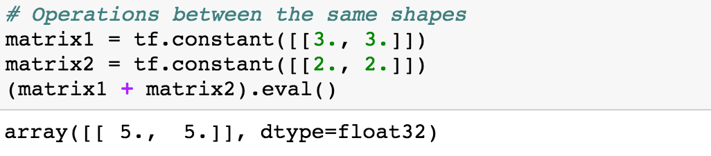
Broadcasting
https://docs.scipy.org/doc/numpy/user/basics.broadcasting.html

Slide 10
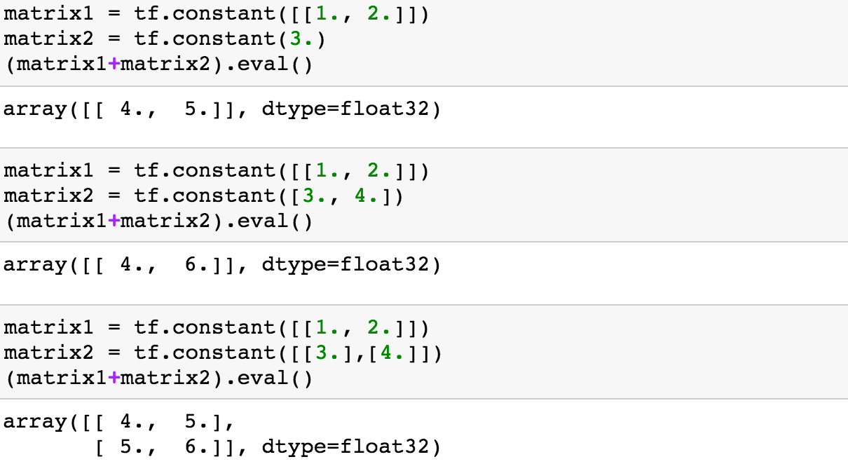
Broadcasting
https://docs.scipy.org/doc/numpy/user/basics.broadcasting.html

Slide 11
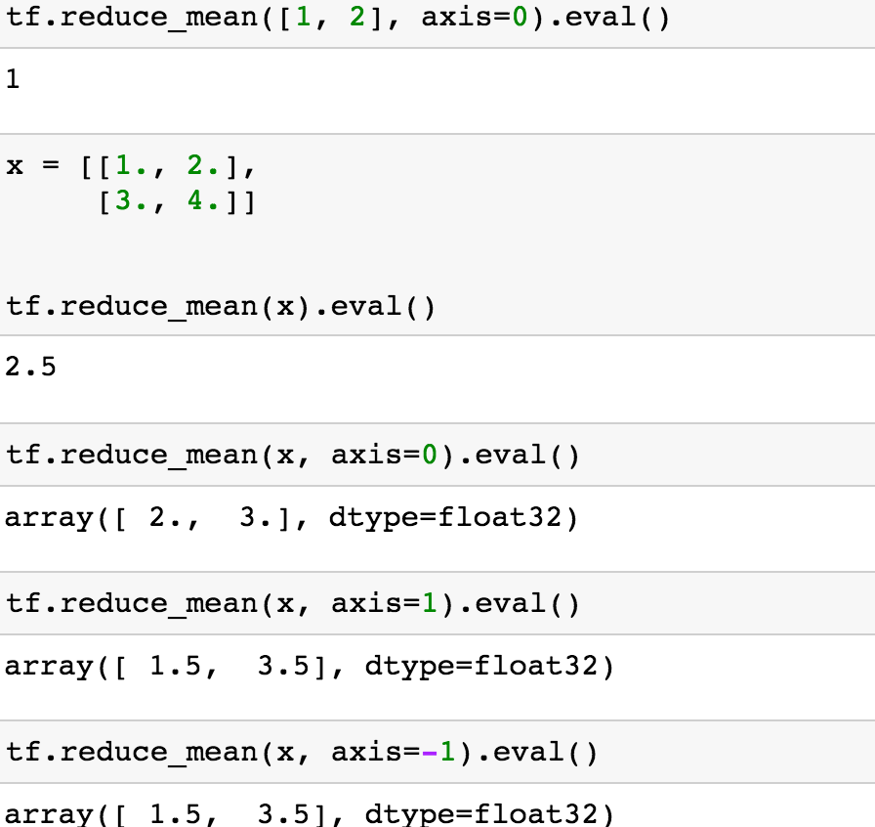
Reduce mean
https://github.com/hunkim/DeepLearningZeroToAll/blob/master/lab-08-tensor_manipulation.ipynb

Slide 12
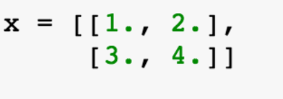
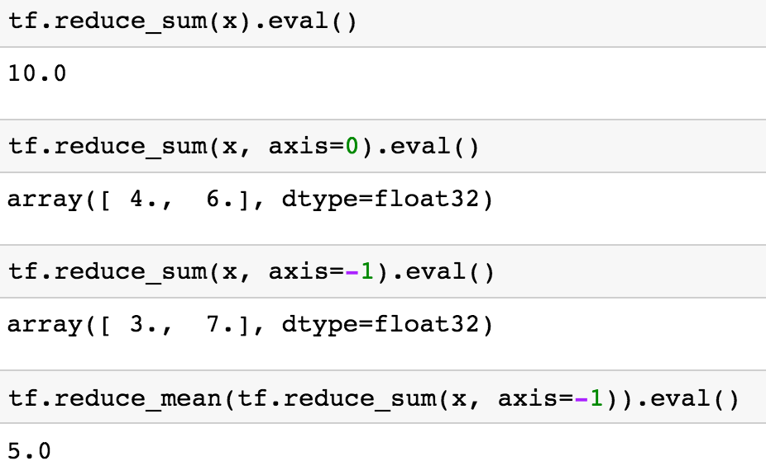
Reduce sum
https://github.com/hunkim/DeepLearningZeroToAll/blob/master/lab-08-tensor_manipulation.ipynb

Slide 13
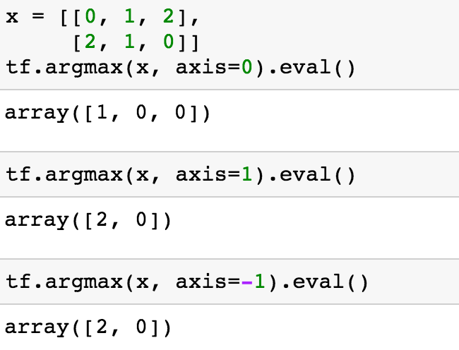
Argmax
https://github.com/hunkim/DeepLearningZeroToAll/blob/master/lab-08-tensor_manipulation.ipynb

Slide 14
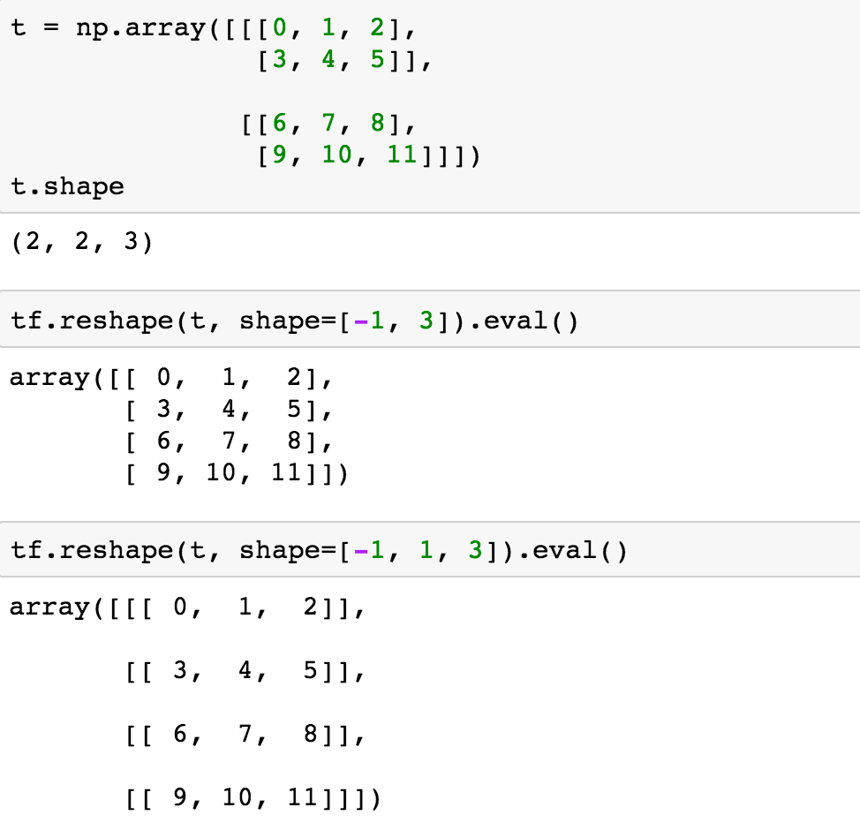
Reshape**
https://github.com/hunkim/DeepLearningZeroToAll/blob/master/lab-08-tensor_manipulation.ipynb

Slide 15
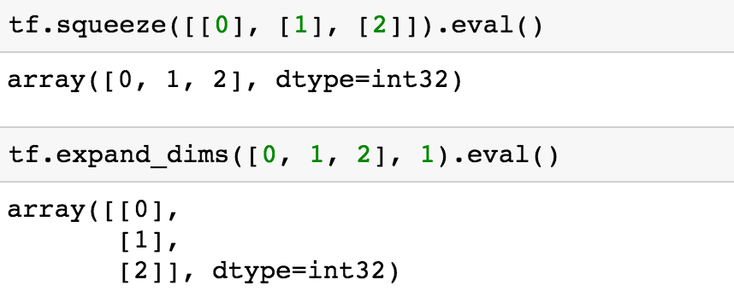
Reshape (squeeze, expand)
https://github.com/hunkim/DeepLearningZeroToAll/blob/master/lab-08-tensor_manipulation.ipynb

Slide 16
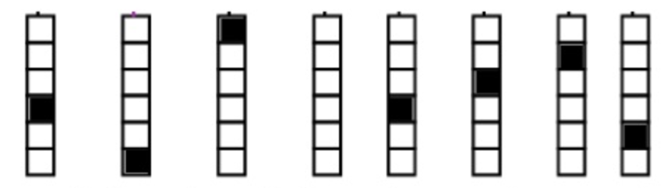
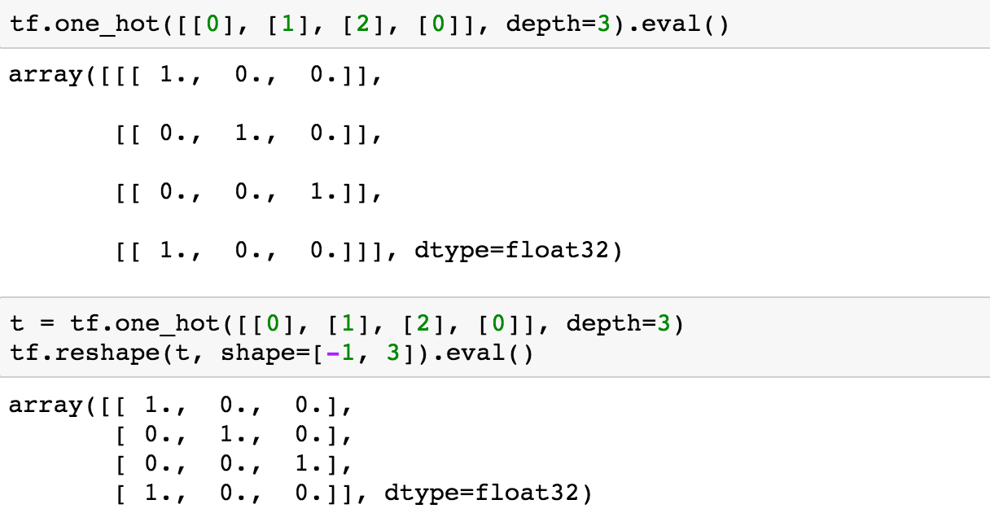
One hot
https://github.com/hunkim/DeepLearningZeroToAll/blob/master/lab-08-tensor_manipulation.ipynb

Slide 17
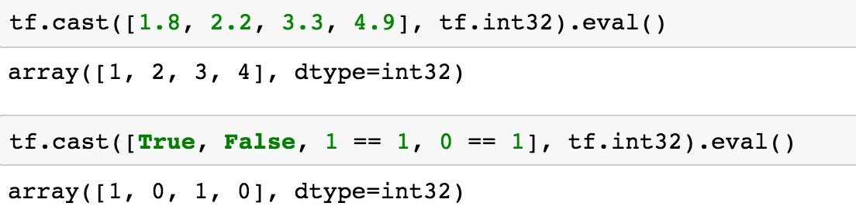
Casting
https://github.com/hunkim/DeepLearningZeroToAll/blob/master/lab-08-tensor_manipulation.ipynb

Slide 18
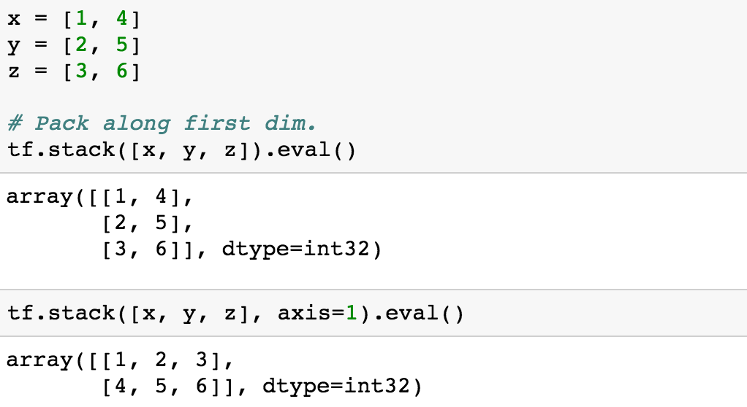
Stack
https://github.com/hunkim/DeepLearningZeroToAll/blob/master/lab-08-tensor_manipulation.ipynb

Slide 19
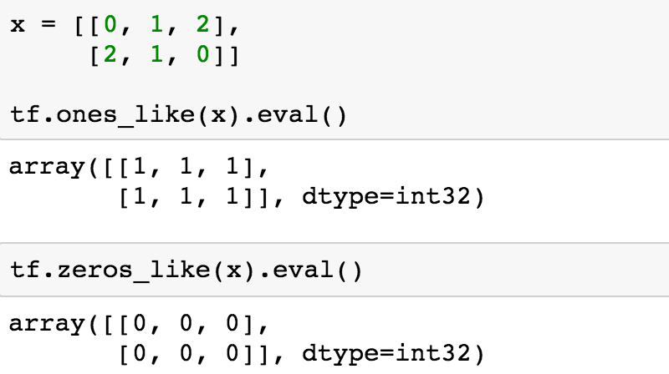
Ones and Zeros like
https://github.com/hunkim/DeepLearningZeroToAll/blob/master/lab-08-tensor_manipulation.ipynb

Slide 20

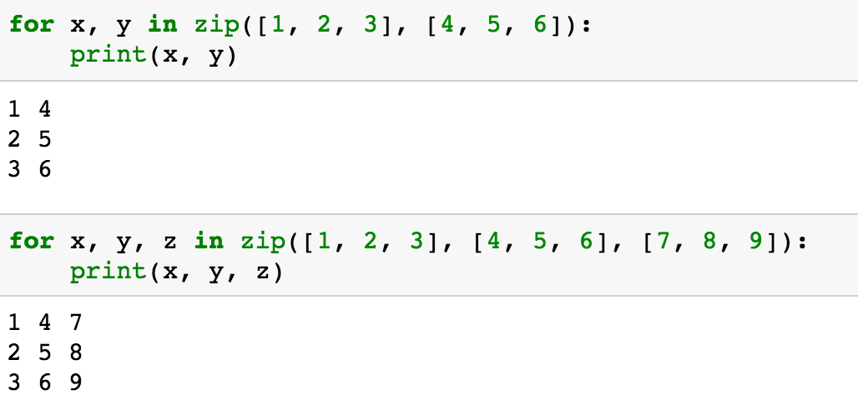
Zip
https://github.com/hunkim/DeepLearningZeroToAll/blob/master/lab-08-tensor_manipulation.ipynb

